Slide 1
Unit One
Data Types & Operators
By: Vanessa Kasun

Slide 2
Introduction to Data Types
Data types are used to classify one particular type of data in programming languages. For instance, a number and a string of characters are different types of data that will be treated differently by JavaScript.
This is important because the specific data type you use will determine what values you can assign to it and what you can do to it. This is to say, to be able to do operations with variables in JavaScript, it is important to understand the data type of any given variable.

Slide 3
JS Data Types
There are different types of data that we can use in a JavaScript Program. For Example:
const x = 5;
const y = “Hello”;
Here…
5 is an integer data
“Hello” is a string data

Slide 4
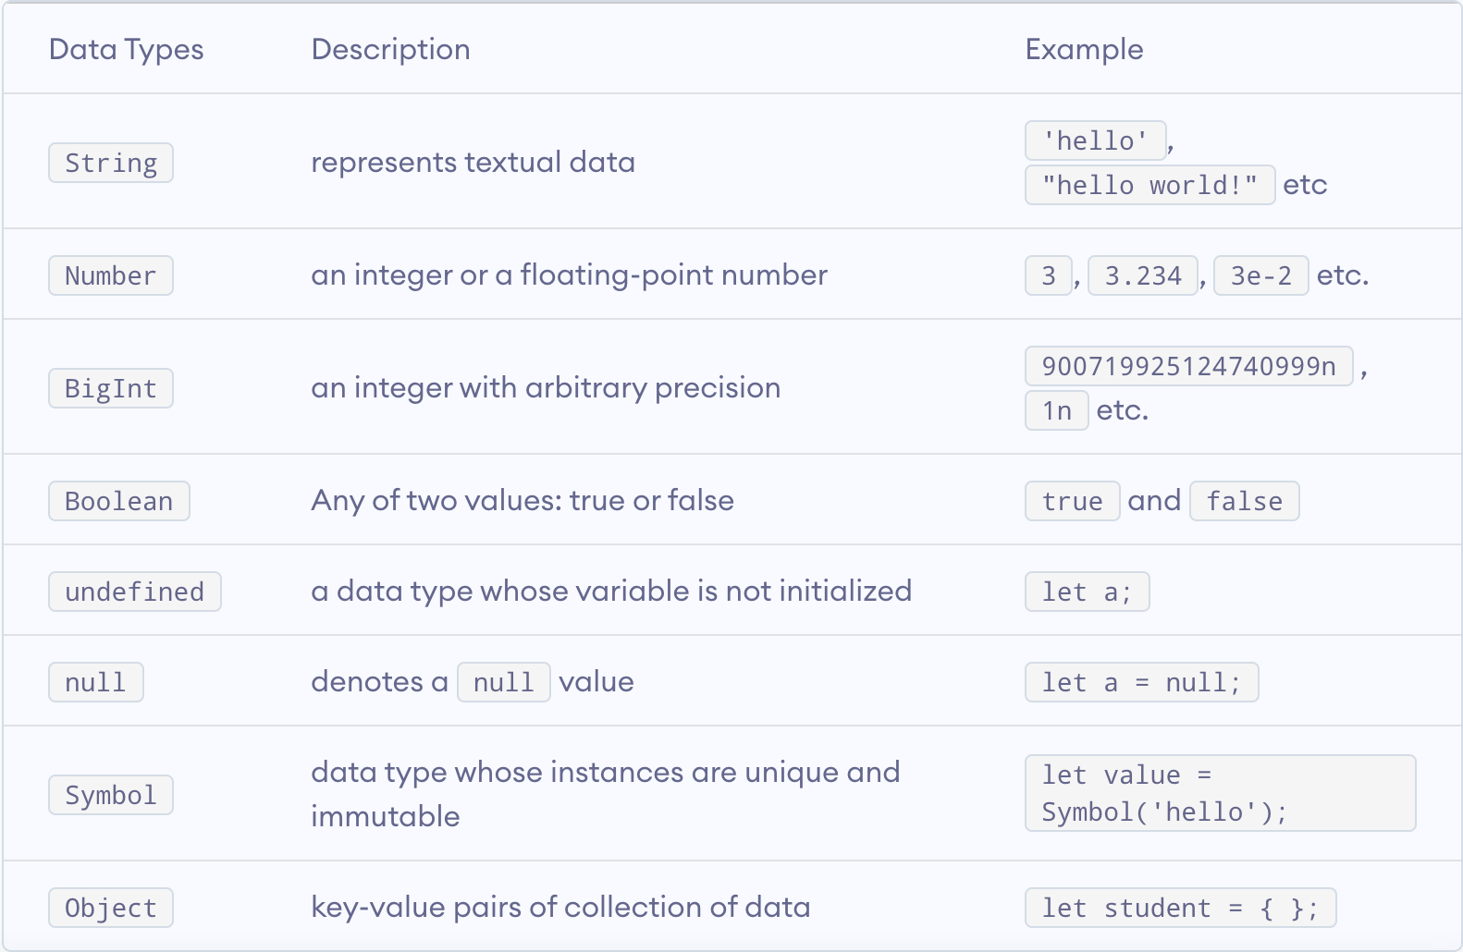
There are eight basic data types in JavaScript. They are: >>>
Here all data types except object, are primitive data types, whereas object is a non-primitive.
Note: The object data type can store a collection of data, where as primitive data types can only store a single data.

Slide 5
Dynamic Typing
JavaScript has dynamic data types, meaning that type checking is done at runtime rather than compile time.
In dynamically typed languages, a variable of the same name can be used to hold different data types. For example
let t = 16; // t is a number
let t = “Hello World”; // t is a string
let t = true; // t is a boolean
let t; // t is undefined
Each of the variables t above can be set to any data type available in JavaScript; they do not need to be explicitly declared with a data type before they are used.

Slide 6
Numbers
JavaScript has only one number type, there is no separate designation for integers and floating-point numbers. Because of this, numbers can be written in JavaScript with or without decimals:
let num1 = 93;
let num2 = 93.00;
In both cases above, the data type is a number and is the same regardless of whether or not the number has decimal points.
Scientific exponential notation can be used in JavaScript to abbreviate very large or small numbers, as in the following examples:
let num3 = 987e8; //98700000000
let num4 = 987e-8; //0.00000987

Slide 7
Numbers in JavaScript are considered to be accurate up to 15 digits. That means that numbers will be rounded after the 16th digit is reached:
let num5 = 999999999999999; //remains as 999999999999999
let num6 = 9999999999999999; //rounded up to 1000000000000000
In addition to representing numbers, the JavaScript number type also has three symbolic values available:
Infinity - a numeric value that represents a positive number that approaches infinity
-Infinity - a numeric value that represents a negative number that approaches infinity
NaN - a numeric value that represents a non-number, standing for not a number
Infinity or -Infinity will be returned if you calculate a number outside of the largest possible number available in JavaScript. These will also occur for values that are undefined, as when dividing by zero:
let num7 = 5 / 0; // will return Infinity
let num8 = -5 / 0; // will return -Infinity

Slide 8
In technical terms, Infinity will be displayed when a number exceeds the number 1.797693134862315E+308, which represents the upper limit in JavaScript.
Similarly, -Infinity will be displayed when a number goes beyond the lower limit of -1.797693134862316E+308.
The number Infinity can also be used in loops:
while (num9 != Infinity) {
// code here will execute through num9 = Infinity
}
NaN - For numbers that are not legal numbers, NaN will be displayed. If you attempt to perform a mathematical operation on a number and a non-numeric value, NaN will be returned. This is the case in the following example:
let x = 20 / “Shark”; // x will be NaN
//the number 20 can’t be divided by the string “Shark” because it can’t be evaluated as a number, the returned value for the x variable is NaN.

Slide 9
However, if a string can be evaluated as a numeric value, the mathematical expression can be performed in JavaScript:
let y = 20 / “5”; //y will be 4
In the above example, since the string "5" can be evaluated as a numeric value in JavaScript, it is treated as such and will work with the mathematical operator for division, /.
When assigning the value NaN to a variable used in an operation, it will result in the value of NaN, even when the other operand is a legal number:
let a = NaN;
let b = 37;
let c = a + b; //c will be NaN
There is only one number data type in JavaScript. When working with numbers, any number you enter will be interpreted as the data type for numbers; you are not required to declare what kind of data type you are entering because JavaScript is dynamically typed.

Slide 10
Strings
A string is a sequence of one or more characters (letters, numbers, symbols). Strings are useful in that they represent textual data.
In JavaScript, strings exist within either single quotes ' or double quotes ", so to create a string, enclose a sequence of characters in quotes:
let singleQuotes = ‘This is a string in a single quotes.’;
let doubleQuotes = “This is a string in double quotes.”;
You can choose to use either single quotes or double quotes, but whichever you decide on you should remain consistent within a program.

Slide 11
The program “Hello, World!” demonstrates how a string can be used in computer programming, as the characters that make up the phrase Hello, World! in the alert() below are a string.
<!DOCTYPE HTML>
<html>
<head>
<script>
function hellFunction() {
alert(“Hello, World!”);
}
</script>
</head>
<body>
<p><button onclick= “helloFunction()”> Click me </button></p>
</body>
</html>
Output:
Hello, World!

Slide 12
As with other data types, we can store strings in variables:
let hw = “Hello, World!”;
And display the string in the alert() by calling the variable:
…
<script>
let hw = “Hello, World!”;
function helloFunction(){
alert(hw);
}
</script>
...
Output:
Hello, World!
-- There are many operations that we can perform on strings within our programs in order to manipulate them to achieve the results we are seeking. Strings are important for communicating information to the user, and for the user to communicate information back to the program. --

Slide 13
Breaking up code lines within strings
In JavaScript, you can declare a line break (or a new line) with the \n character.
The document.write() method writes a string of text to a document stream opened by document.open()
let lineBreak = ‘\n’;
document.write(“\n”); // new line in js
//second method for html page
document.write(“<br>”);

Slide 14
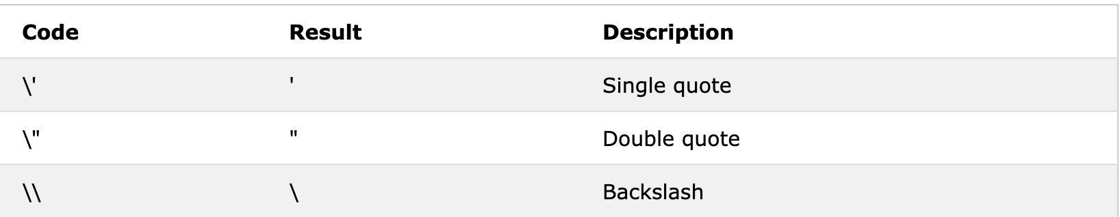
Escaping Characters
Because strings must be written within quotes, JavaScript will misunderstand the following string...
The solution to avoid this problem, is to use the backslash escape character.
The backslash (\) escape character turns special characters into string characters:
var x = “We are the so-called “Vikings” from the north.”;

Slide 15
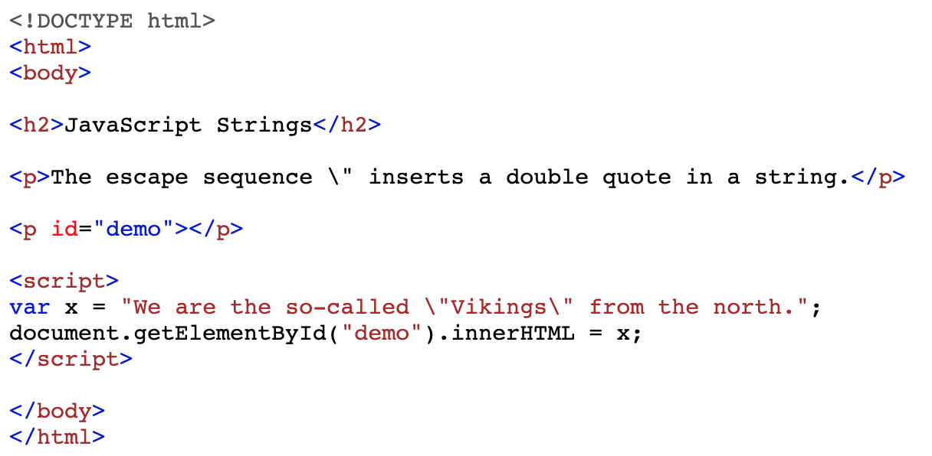
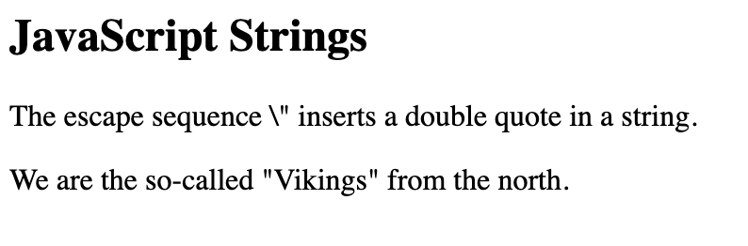
The sequence \” inserts a double quote in a string:
var x = “We are the so-called \“Vikings\” from the north.”;
Output:

Slide 16
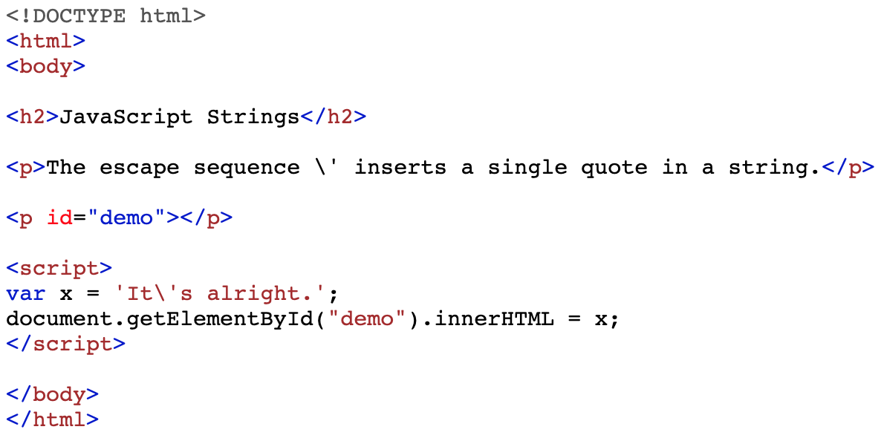
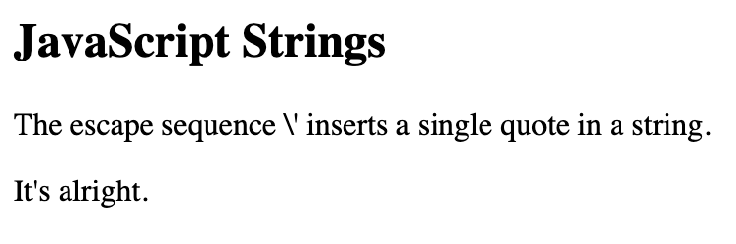
The sequence \” inserts a double quote in a string:
var x = ‘ It\’s alright.’;
Output:

Slide 17
Concatenation
There are 3 ways to concatenate string in JavaScript.
Using the + operator
2.)You can also use +=, where a += b is a shorthand for a = a + b
const str = “Hello” + “ “ + “World!”;
console.log(str); // “Hello World!”
const str = “Hello”;
str =+ “ ”;
str =+ “ World!”;
console.log(str); // “Hello World!”

Slide 18
3.) If the left hand side of the + operator is a string, JavaScript will coerce the right hand side to a string. That means it is safe to concatenate objects, numbers, null, and undefined.
let str = 'Values: ';
str += 42; // Values: = Values: + 42
str += ' '; // Values: + 42 = Values: + 42 + ‘ ‘
str += {}; // Values: + 42 + ‘ ‘ = Values: + 42 = Values: + 42 + //‘ ‘ + {}
str += ' '; ...
str += null; ...
console.log(str); // 'Values: 42 [object Object] null'
The + and += operators are fast on modern JavaScript engines, so no need to worry about something like Java's StringBuilder class.

Slide 19
Template Literals
Template Literals are a new ES2015 / ES6 feature that allows you to work with strings in a novel way compared to ES5 and below.
The syntax at a first glance is very simple, just use backticks instead of single or double quotes.
const a_string = `something`;
They are unique because they provide a lot of features that normal strings built with quotes do not, in particular:
they offer a great syntax to define multiline strings
they provide an easy way to interpolate variables and expressions in strings
they allow you to create DSLs with template tags (DSL means domain specific language, and it’s for example used in React by Styled Components, to define CSS for a component)
Let’s dive into each of these details.

Slide 20
Template Literals - multiline strings
Pre-ES6, to create a string spanning over two lines you had to use the \ character at the end of a line. This allows you to create a string on 2 lines, but it’s rendered on just one line.
const string = ‘first part \
second part’;
// output >> first part second part
-- RECAP --: To render a string on multiple lines as well, you explicitly need to add \n at the end of each line.
const string = ‘first line\n \
second line’;
OR
const string = ‘first line\n’ + ‘second line’;

Slide 21
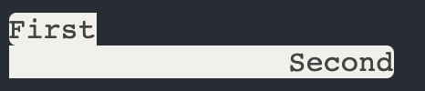
Template literals make multiline strings much simpler.
Once a template literal is opened with the backtick, you just press enter to create a new line, with no special characters, and it’s rendered as is:
Keep in mind that space is meaningful, so doing this:
const string = `hey
this
string
is awesome`;
const string = `first
second`
Is going to create a string like this:

Slide 22
an easy way to fix this problem is by having an empty first line, and appending the trim() method right after the closing backtick, which will eliminate any space before the first character:
const string = `
First
Second`.trim();

Slide 23
Unicode
If not specified otherwise, the browser assumes the source code of any program to be written in the local charset, which varies by country and might give unexpected issues. For this reason, it’s important to set the charset of any JavaScript document.
Unicode represents a character in an abstract way and leaves the visual rendering (size, shape, font, or style) to other software, such as a web browser or word processor.
The idea behind unicode
Let’s start with an elementary question. How are you able to read and understand the current article? Simply: because you know the meaning of letters and words as a group of letters.
Why are you able to understand the meaning of letters? Simply: because you (reader) and me (writer) have an agreement over the association between the graphical symbol (what is seen on the screen) and the English language letter (the meaning).
The same happens with computers. The difference is that computers don’t understand the meaning of letters: these are just sequences of bits.

Slide 24
Imagine a scenario...
When User1 sends a message ‘hello’ to User2 through network…
User1’s computer doesn’t know the meaning of letters. So it transforms 'hello' into a sequence of numbers 0x68 0x65 0x6C 0x6C 0x6F, where each letter uniquely corresponds to a number: h is 0x68, e is 0x65, etc. These numbers are sent to User2’s computer.
When the computer of User2 receives the sequence of numbers 0x68 0x65 0x6C 0x6C 0x6F, it uses the same letter to number correspondence and restores the message. Then it displays the correct message: 'hello'.
The agreement between the two computers about the correspondence between letters and numbers is what Unicode standardizes

Slide 25
Unicode in JavaScript
I recommend keeping the source code text with characters from Basic Latin Unicode block (or ASCII). Characters outside ASCII should be escaped. This will ensure fewer problems when comes to encoding.
Internally, at the language level, ECMAScript 2015 provides an explicit definition what strings are in JavaScript:
“The String type is the set of all ordered sequences of zero or more 16-bit unsigned integer values (“elements”) up to a maximum length of 253-1 elements. The String type is generally used to represent textual data in a running ECMAScript program, in which case each element in the String is treated as a UTF-16 code unit value.”

Slide 26
Unicode in JavaScript
Every element of a string is interpreted by the engine as a code unit. The way a string is rendered does not provide a deterministic way to decide what code units (that represent code points) it contains. See the following example:
console.log(‘cafe\u0301’); //=> ‘café’
console.log(‘café’); //=> ‘café’
'cafe\u0301' and 'café' literals have slightly different code units, but both are rendered the same sequence of symbols café.
More on Unicode

Slide 27
Numeric Strings
var x = 100; // x is a number
var y = "100"; // y is a string
JavaScript will try to convert strings to numbers in all numeric operations:
This will work:
And this will work:
var x = "100";
var y = "10";
var z = x - y; // z will be 90
var x = "100";
var y = "10";
var z = x / y; // z will be 10
But this will not work:
This will also work:
var x = "100";
var y = "10";
var z = x + y; // z will not be 110 (It will be 10010)
var x = "100";
var y = "10";
var z = x * y; // z will be 1000
In the last example JavaScript uses the + operator to concatenate the strings.

Slide 28
Booleans
The Boolean data type can be one of two values, either true or false. Booleans are used to represent the truth values that are associated with the logic branch of mathematics, which informs algorithms in computer science.
greater than
500 > 100 true
1 > 5 false
less than
200 < 400 true
4 < 2 false
Equal
5 = 5 true
500 = 400 false

Slide 29
Like with other data types, we can store a Boolean value in a variable:
let myBool = 5 > 8; //false
Since 5 is not greater than 8, the variable myBool has the value of false.
As you write more programs in JavaScript, you will become more familiar with how Booleans work and how different functions and operations evaluating to either true or false can change the course of the program.

Slide 30
Comparison Operators
Comparison operators - operators that compare values and return true or false
< - returns true if the value on the left is less than the value on the right, otherwise it returns false.
> - returns true if the value on the left is greater than the value on the right, otherwise it returns false.
<= - returns true if the value on the left is less than or equal to the value on the right, otherwise it returns false.
>= - returns true if the value on the left is greater than or equal to the value on the right, otherwise it returns false.
== (equal to)- used for comparing two variables, but it ignores the datatype of the variable.
=== (equal value and equal type) - used for comparing two variables AND checks datatype and compares two values.
!== (not equal to)- returns true if the value on the left is not equal to the value on the right, otherwise it returns false.
!=== (not equal value or not equal type)- returns true if the value on the left is not equal to the value on the right, otherwise it returns false.

Slide 31
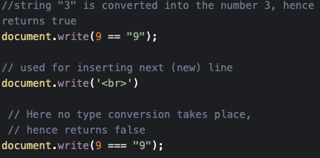
== vs ===
The ‘==’ operator tests for abstract equality i.e. it does the necessary type conversions before doing the equality comparison.
But the ‘===’ operator tests for strict equality i.e it will not do the type conversion hence if the two values are not of the same type, when compared, it will return false.

Slide 32
Logical Operators
Logical Operators - operators that combine multiple boolean expressions or values and provide a single boolean output. The operators include
&& (and) - this operator will be truthy(act like true) if and only the expressions on both sides of it are true
|| (or) - this operator will be truthy if the expression on either side of it is true. Otherwise, it will be falsy(act like false)

Slide 33
Example of using operators
var isTrue = (‘yellow’ === ‘green’ ) && ( 4 >= 4 );
In this example, we check if the string ‘yellow’ is equal to the string ‘green’ and (&&) if 4 is greater than 4. Let's break this down into the two comparison expression.
The first expression is false because the string ‘yellow’ is not the same (equal) as the string ‘green’
The second statement is true, because the number 4 is greater than or equal to 4.
The && operator requires that both expressions be true in order for the expression to be truthy. Because one expression is false and the other is true, the expression is falsy and evaluates to false.

Slide 34
Arrays
An array can hold multiple values within a single variable. This means that you can contain a list of values within an array and iterate through them.
Each item or value that is inside of an array is called an element. You can refer to the elements of an array by using an index number.
Just as strings are defined as characters between quotes, arrays are defined by having values between square brackets [ ].
An array of strings, for example, looks like this:
Arrays are a very flexible data type because they are mutable in that they can have element values added, removed, and changed.
let fish = [‘shark’, ‘cuttlefish’, ‘clownfish’, ‘eel’];
If we call the variable fish, we’ll receive the following output:
[‘shark’, ‘cuttlefish’, ‘clownfish’, ‘eel’]

Slide 35
Zero-Based (arrays continued)
Arrays in JavaScript are zero-based.
This means that JavaScript starts counting from zero when it indexes an array. In other words, the index value of the first element in the array is “0” and the index value of the second element is “1”, the third element’s index value is “2”, and so on.
In Example # 1, we have an array with five elements. The console.log() statement reflects this as well because the “length” property of this array is “5” (i.e. this is a one-based value).
If a JavaScript array has four elements, then that array’s “length” property will have a value of “four”. But (and here is the point where many get confused), if a JavaScript array has four elements, the last element has an index of “3”. This is because, again, JavaScript arrays are zero-based.
var arr = [‘monday’, ‘tuesday’, ‘wednesday’, ‘thursday’, ‘friday’];
console.log(arr.length); //output => 5

Slide 36
JavaScript Objects
An object in JS is a non-primitive data type. It is like any other variable, the only difference is that the object holds multiple values in terms of properties and methods.
Properties can hold values of primitive data types and methods are function(tasks/set of instructions)
In other programming languages like Java or C#, you need a class to create an object of it. In JavaScript, an object is a standalone entity because there is no class in JavaScript. However, you can achieve class like functionality using functions. We will learn how to treat a function as a class in the advance JavaScript section.

Slide 37
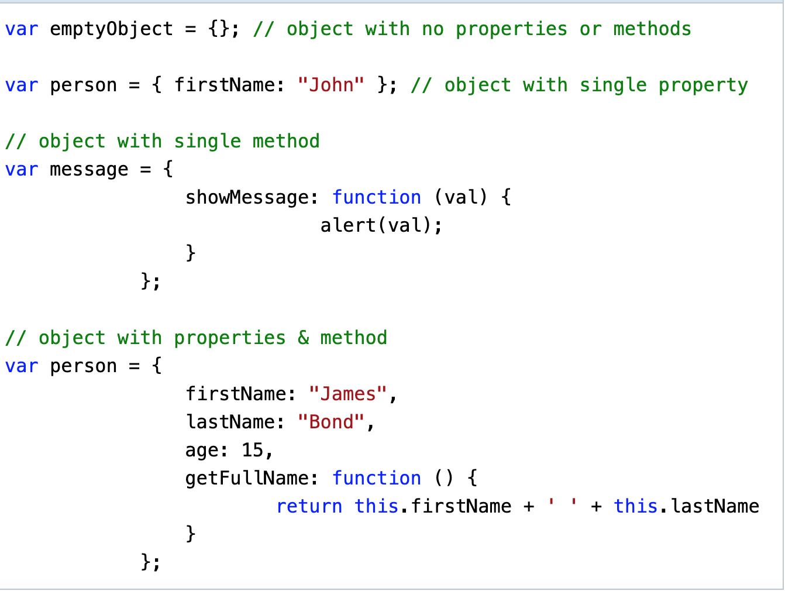
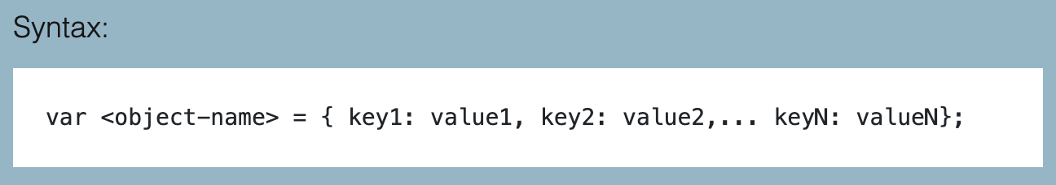
In JavaScript, an object can be created in two ways:
Object literal
Object constructor
Object Literal - The object literal is a simple way of creating an object using { } brackets. You can include key-value pair in { }, where key would be property or method name and value will be value of property of any data type or a function. Use comma (,) to separate multiple key-value pairs.
Syntax:
The following example creates an object using object literal syntax.

Slide 38
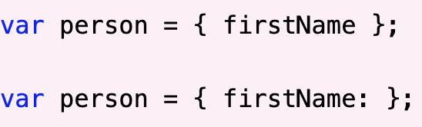
NOTE:
You must specify key-value pair in object properties or methods.
Only property or method name without a value is not valid. The follow syntax is invalid:

Slide 39
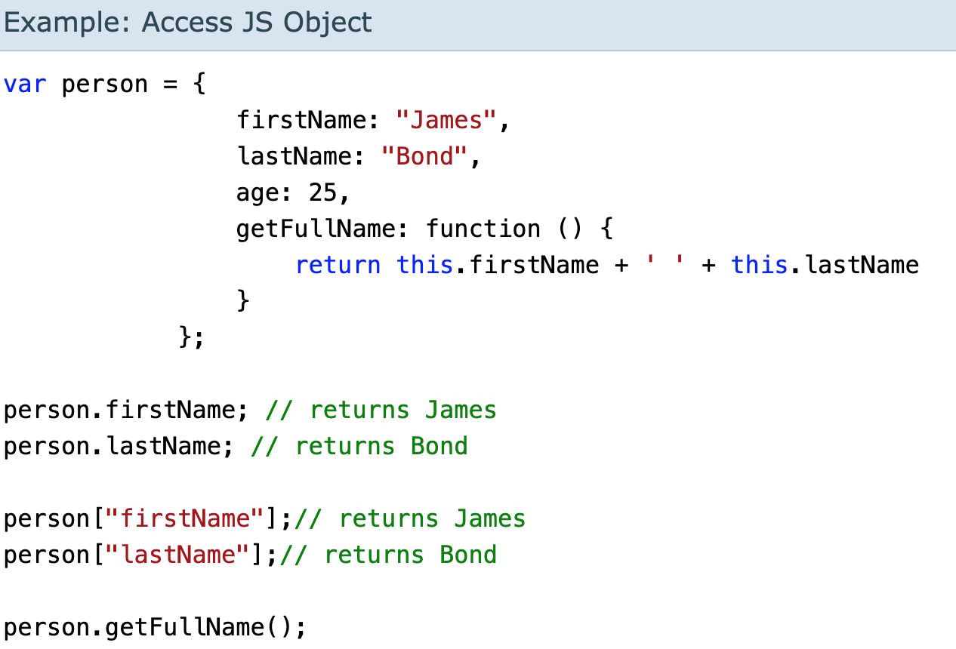
Accessing JavaScript object Properties and Methods
You can get ot set values of an object’s properties using dot notation or brackets. However, you can call an object’s method only using dot notation.
Note: An object’s methods can be called using () operator.
e.g.
person.getFullName(). Without (), it will return function definition

Slide 40
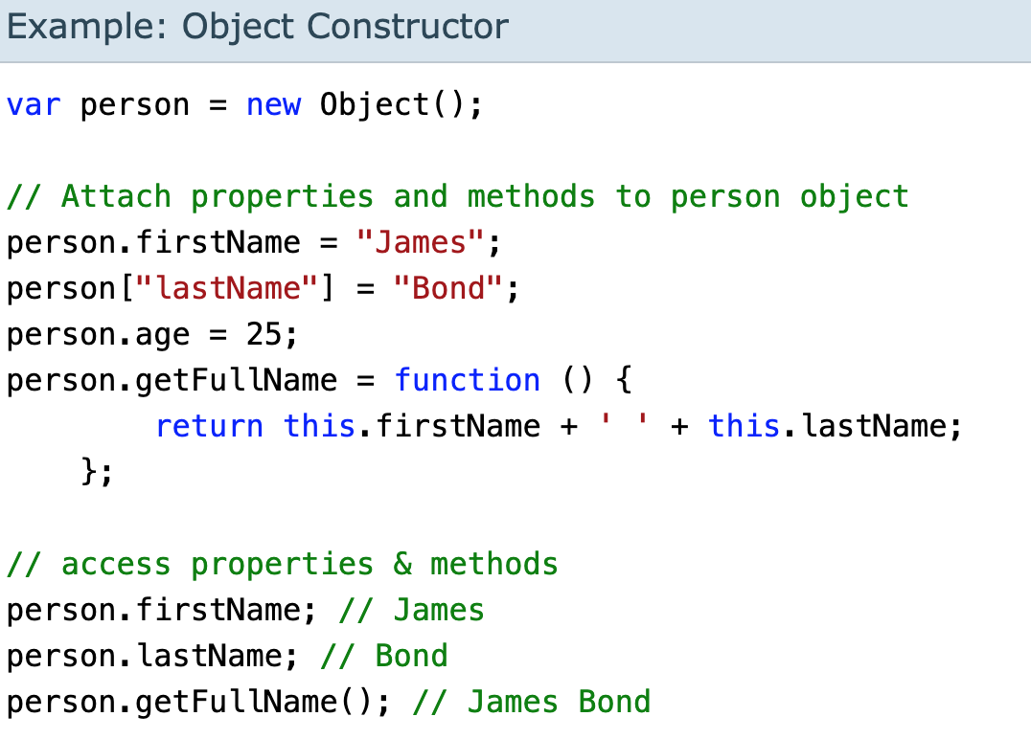
Object Constructor
The second way to create an object is with Object Constructor using the “new” keyword. You can attach properties and methods using dot notation. Optionally, you can also create properties using [ ] brackets and specifying property name as string.

Slide 41
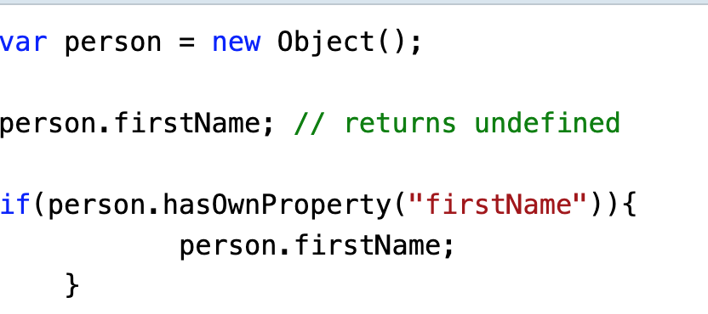
Undefined Property or Method
JavaScript will return ‘undefined’ if you try to access properties ot call methods that do not exist.
If you are not sure whether an object has a particular property or not, then use the hasOwnProperty() method before accessing properties.

Slide 42
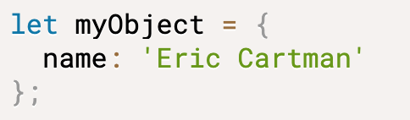

Null
Objects are complex data structures. The simplest object in js is the plain object - a collection of keys and associated values
But there are situations when an object cannot be created. For such cases, js provides a special value, null -- which indicates a missing object.
If you see a null (either assigned to a variable or returned by a function), then at that place should have been an object, but for some reason, an object wasn’t created. Let’s look at an example....

Slide 43
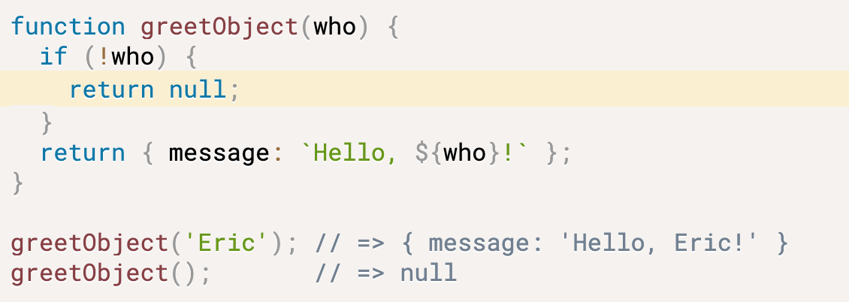
For example, the function greetObject() creates objects, but also can return null when an object cannot be created:
When invoking the function with a string argument like greetObject('Eric'), as expected, the function returns an object { message: 'Hello, Eric!' }.
However, when invoking the function with no arguments — greetObject() — the function returns null. Returning null is reasonable because who parameter has no value, and the greeting object cannot be created.

Slide 44

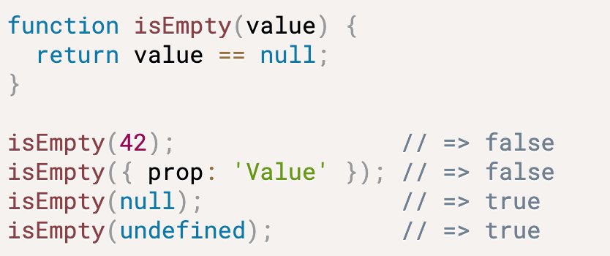

Null vs Undefined
The main difference between null and undefined is that null represents a missing object while undefined represents an uninitialized state.
The strict equality operator (===) distinguishes between null from undefined:
While the loose equality operator (==) considers null and undefined equal
I use the loose equality operator to check whether a variable is null or undefined:

Slide 45
typeOf
The main difference between null and undefined is that null represents a missing object while undefined represents an uninitialized state.
The strict equality operator (===) distinguishes between null from undefined:
While the loose equality operator (==) considers null and undefined equal
I use the loose equality operator to check whether a variable is null or undefined:

Slide 46
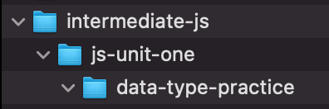
Let’s put our knowledge to the test and practice using these concepts! :)
Create a JavaScript Class Folder on your C:\ Drive. (or your root drive, whichever is fitting) (this will house all of this class’s project folders).
Inside of the folder you just created; create a new folder called “js-unit-one”.
Inside of that folder create another folder called “data-type-practice”.
Open up this folder in Visual Studio Code and wait for further instructions.
When you are finished, your file structure should look like this...

